Slide 1
Chapter 8:
Recursion
Data Structures in Java: From Abstract Data Types to the Java Collections Framework
by Simon Gray

Slide 2
Introduction
A recursive definition is one in which the thing being defined is part of the definition
Application in
  specification of programming language elements
  data structures
  functions
For computing, this is another way to do iteration

Slide 3
Recursion in Programming Languages
Two components of a compiler
  scanner - assembles characters from the source file into “words” recognized by the language
  parser – assemble words into phrases recognized by the language
Language specification includes rules for how to construct “words” and phrases -> the language’s grammar

Slide 4
Lexical Specification of an Identifier
Backus Naur Form (BNF) – a metalanguage to specify the elements
of a language: terminals, non-terminals and productions
Rule Number | Rule
 | Term | Definition
1 | <underscore> | ::= | _
2 | <letter> | ::= | a | b | c | d | e | f | g | h | i | j | k | l | m | n | o | p | q | r | s | t | u | v | w | x | y | z
 |  |  | | A | B | C | D | E | F | G | H | I | J | K | L | M | N | O | P | Q | R | S | T | U
 |  |  | | V | W | X | Y | Z
3 | <digit> | ::= | 0 | 1 | 2 | 3 | 4 | 5 | 6 | 7 | 8 | 9
4 | <identifier> | ::= | <letter> |
5 |  |  | <underscore> |
6 |  |  | <identifier> <letter> |
7 |  |  | <identifier> < digit> |
8 |  |  | <identifier> <underscore>
Rules 6 – 8 are self-
referential; the lexical
element being defined
appears in its own
definition! Recursion!

Slide 5
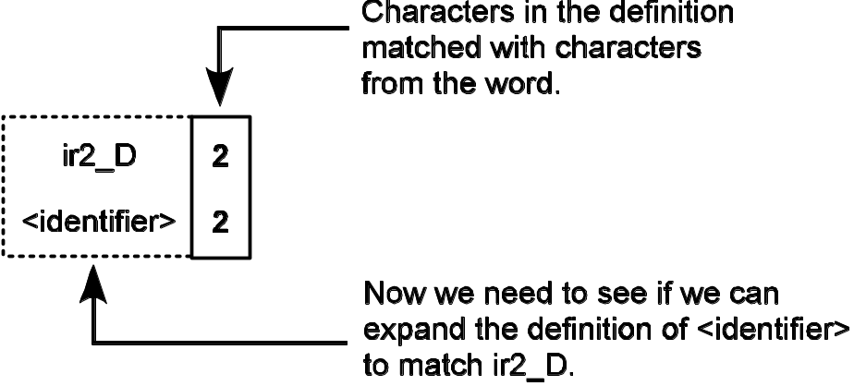
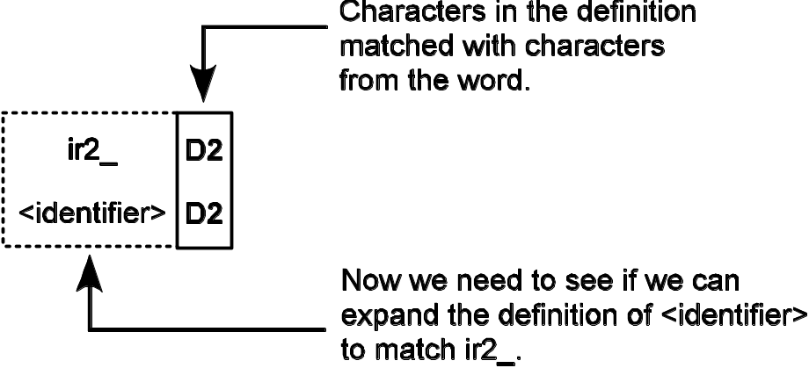
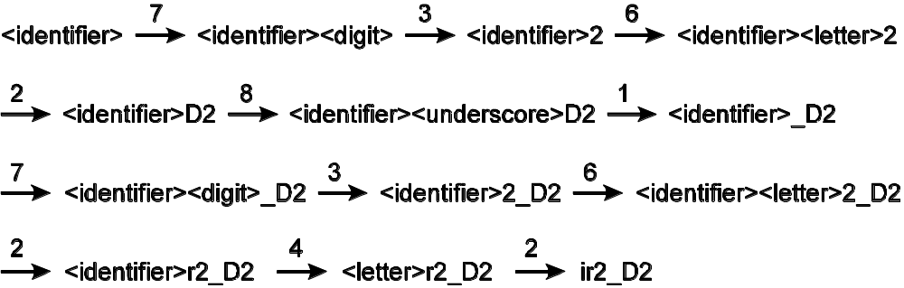
Derivation of identifier ir2_D2
Recursively apply the rules to smaller versions of
the original problem until the input has been parsed.
The numbers
above the
arrows are
rule numbers.

Slide 6
Parts of a Recursive Definition
The example gives us an important insight into recursive definitions. Every recursive definition contains two parts:
a base case, which is non-recursive and, consequently, terminates the recursive application of the rule. Rules 4 and 5 provide the base cases for <identifier>
a recursive case, which reapplies a rule. In BNF, these are the rules for non-terminals whose definition is self-referential. Rules 6, 7, and 8 provide the recursive cases for <identifier>

Slide 7
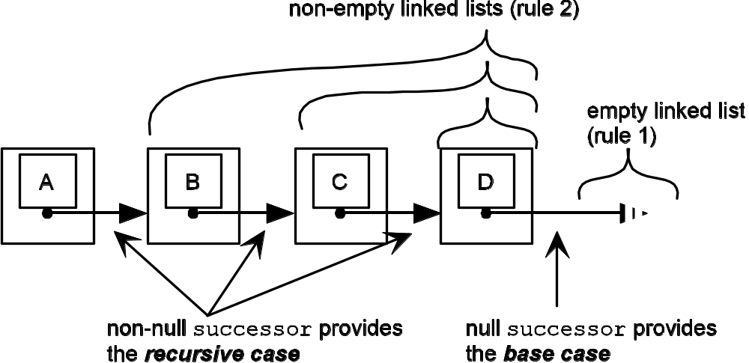
Recursion & Data Structures: Linked List
A singly linked list viewed from a recursive perspective

Slide 8
Recursion & Data Structures: Linked List
Rule Number | Rule
 | Term | Definition
1 | <LinkedList> | ::= | null |
2 |  |  | <SLNode>
3 | <SLNode> | ::= | <DataField> < Successor >
4 | <Successor> | ::= | <LinkedList>
A BNF definition of a singly linked data structure
Note: The recursion here is indirect.
LinkedList ⇒ SLNode ⇒ Successor ⇒ LinkedList

Slide 9
Java Corresponding to BNF Description
1 /**
2 * A single node in a singly linked structure.
3 */
4 public class SLNode<E> {
5 private E dataField;
private SLNode successor; // Recursive part
7 . . .
8 }
Compare this to Rule 3 from the previous slide.
Once you have the recursive definition, the
implementation frequently follows quite naturally.

Slide 10
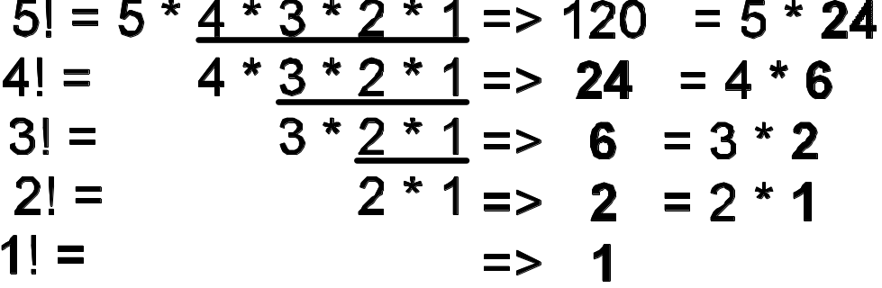
Recursion & Functions
Trivial example: factorial function
1, if n == 1 base case
n! =
n (n – 1)!, if n > 1 recursive case

Slide 11
Key Characteristic of Recursive Problem Solving
A key characteristic of recursive problem solving, evident from the factorial example, is that each recursive application of the definition deals with a subproblem that
  has the same organization as the original problem.
  is closer to the base case than the original problem.
Go back and look at the identifier example (ir2_D2)
and the linked list examples in light of this observation.

Slide 12
From Definition to Method
Earlier we said that once you have the recursive
definition, the implementation follows fairly naturally.
Recursive Definition |  | Recursive Method
n! if n is 1, then n! = 1 if n > 1, then n! = n * (n – 1)! | function base case recursive case | 1 long factorial( int n ) { 2 if ( n == 1 ) return 1; 3 return n * factorial( n – 1 ); 4 }

Slide 13
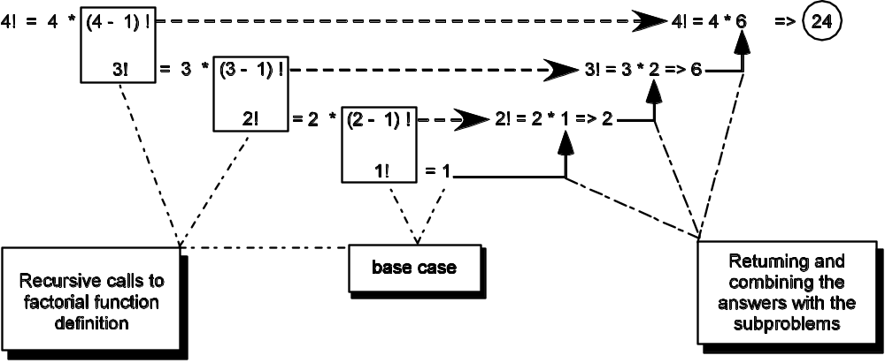
Unwinding Recursive Calls
Observe that in many recursive methods, the work is
done after the base case has been met and the recursion
unwinds back to the original call. In the example here,
the computation is done as the recursion unwinds.

Slide 14
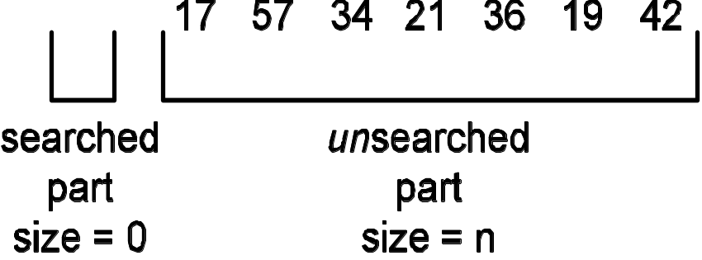
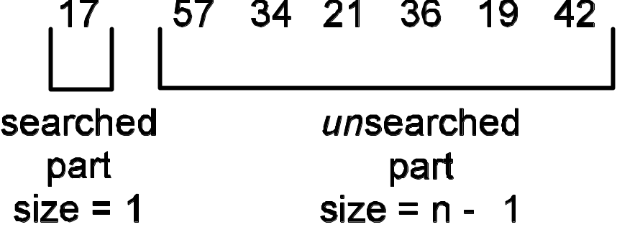
Recursive Linear Search
View unsorted input as consisting of a “search part” and an “unsearched part”
Leads to a nice recursive definition (next slide)
original problem: find the
target in the unsearched part
“new” problem is the same: find the target in the unsearched part

Slide 15
Linear Search: Recursive Definition
failure, if first > last base case
SequentialSearch(collection,
first,
last,
target)
success, if collection(first) is equal to the target
base case
SequentialSearch(collection, first + 1, last, target)
recursive case
where:
collection – the collection of elements to search
first – the index of the first element in the unsearched part
last – the index of the last element in the unsearched part
target – the element we are searching for
What does this cost? O(n) because each comparison “moves”
only one element from the unsearched to the searched part and,
in the worst case, we will need to look at all n elements.

Slide 16
Binary Search Definition
What if the input is sorted? Can we get more out of each comparison. Oh, yes!
BinarySearch(collection,
first,
last,
target)
failure, if first > last base case
success, if collection(mid) is equal to the target base case
BinarySearch(collection, first, mid - 1, target), if target < collection(mid) recursive case
BinarySearch(collection, mid + 1, last, target) , if target > collection(mid) recursive case
where:
collection – the collection of elements to search
first – the index of the first element in the unsearched part
last – the index of the last element in the unsearched part
mid – (first + last) / 2
target – the element we are searching for
Note: 2 base cases
and 2 recursive cases

Slide 17
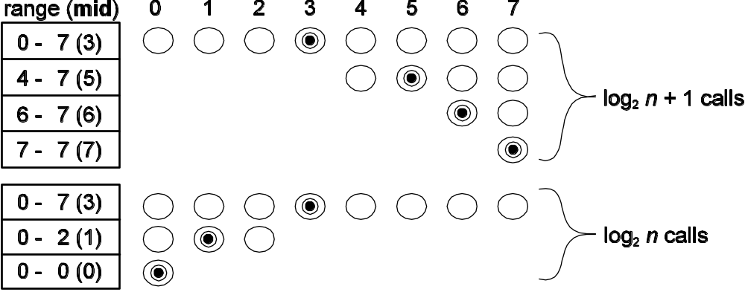
Binary Search: The Picture
What does this cost? O(log₂n) because now each comparison “moves” half of the unsearched to the searched part. In the worst case, we will need to look at about log₂n elements!

Slide 18
Finding the k^{th} Smallest Value
Problem: To find the k^{th} smallest value in a collection
If the collection is sorted, the k^{th} smallest value is position k-1
What if the input isn’t sorted?
  We could sort it, but that is a lot of work. Can we get away with less?
  Yes! Sort only enough to reveal the k^{th} smallest values

Slide 19
k^{th} Smallest Value: Partitioning
Idea: partition the input around a pivot value so that you have the following
Elements in the partitions to the left and right of the pivot value are not sorted with respect each other, but they are sorted with respect to the pivot value.
This means the pivot value is in its final, “sorted” position. If this position is k – 1, you have the kth smallest value. So, we keep partitioning until the pivot ends up in position k – 1.

Slide 20
k^{th} Smallest Value: Recursive Definition
array[pivotPosition], if pivotPosition is equal to k – 1 base case
kthSmallest( k, array, first,
last)
kthSmallest( k, array, first, pivotPosition –1) , if k – 1 < pivotPosition recursive case
kthSmallest( k, array, pivotPosition +1, last) , if k – 1 > pivotPosition recursive case
where
pivotPosition – the index of the pivot after partitioning
first – the index of the first element of the region of the array to examine
last – the index of the last element of the region of the array to examine

Slide 21
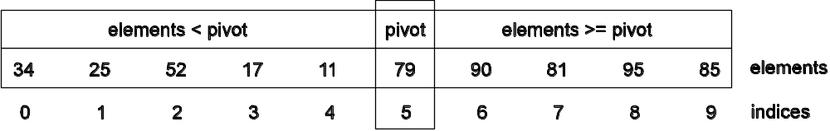
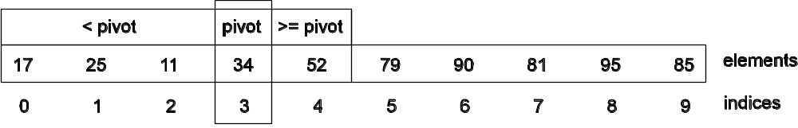
k^{th} Smallest Value: An Example
(a) An unsorted array using the elements.
(b) The array after partitioning around the pivot value 79.
(c) The array after repartitioning around the pivot value 34 using only the left partition of the array from (b).
The fourth smallest element in an array of 10 unsorted elements is in position 3

Slide 22
Good Pivots and Bad Pivots
Behavior of the algorithm depends heavily on the partition step splitting a partition into two partitions of roughly equal size
This depends on the pivot value
  ☺ Pivot: the median value on the partition
  ☹ Pivot: the smallest or largest value in the partition
We revisit this issue in the next chapter.

Slide 23
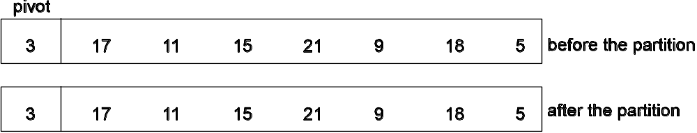
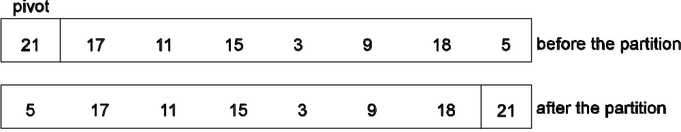
Good Pivots and Bad Pivots
A good pivot choice splits the array into two equal partitions
Not good:
empty left
partition
(a) Partitioning when pivot is the smallest value in the array
Not good:
empty right
partition
(b) Partitioning when pivot is the largest value in the array

Slide 24
The Partition Algorithm
Pseudocode: partition()
1. start the right scanner one position above the pivot
2. start the left scanner at the last position
3. while the left and right scanners haven’t crossed
4. scan right looking for a value >= the pivot
5. scan left looking for a value < the pivot
6. if the scanners haven’t crossed
7. swap the values at the right and left scanner positions
8. // loop invariant: all values to the left of the right scanner are < pivot
9. // all values to the right of the left scanner are >= pivot
10. swap the pivot with the value in the left scanner position
11. // post-condition: all values to the left of the pivot’s position are < pivot
12. // all values to the right of the pivot’s position are >= pivot

Slide 25
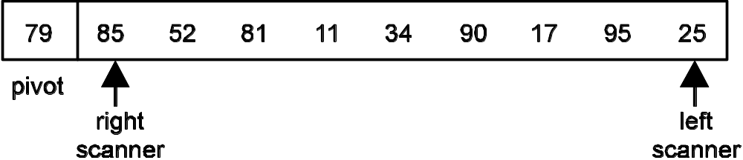

Partition in Action : Part 1
(a) Array after first scan with right and left scan markers
(b) Array after swapping the values at the right and left scan markers

Slide 26
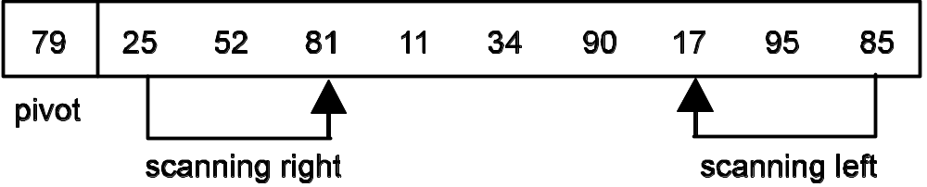
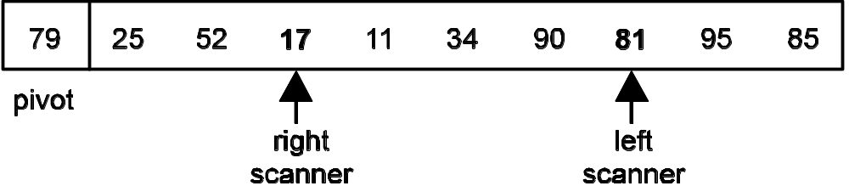
Partition in Action: Part 2
(c) Continuing the right and left scans
(d) Array after swapping the values at the right and left scan markers

Slide 27
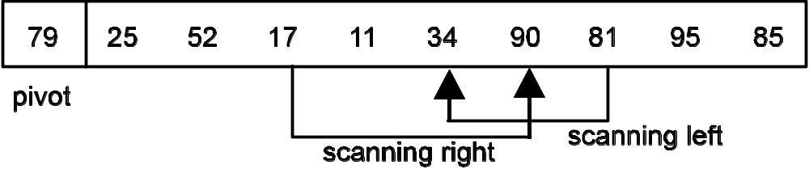
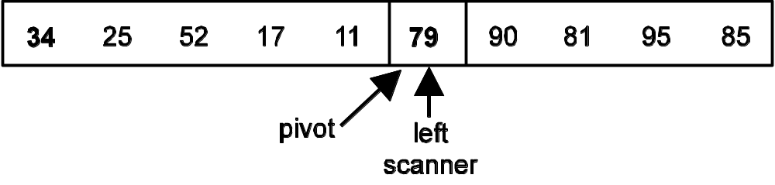
Partition in Action: Part 3
(e) Scanning ends when the scanning indices cross
elements < pivot
elements ≥ pivot
(f) The array after swapping the pivot with the value in the position of the left scanner

Slide 28
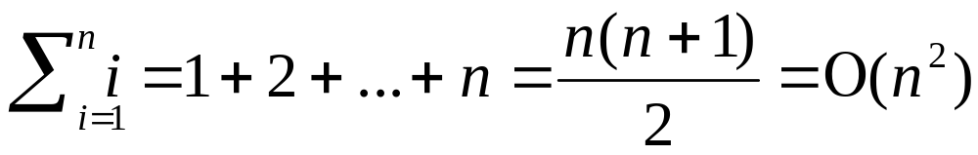
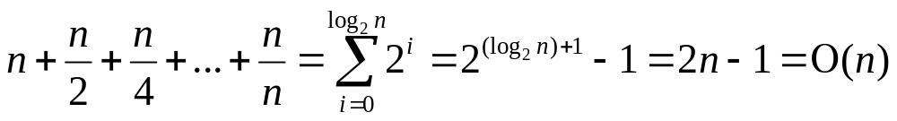
Partition Cost: Time Complexity
Worst case: each partition step produces one empty partition, and the rest of the elements (except the pivot) are in the other partition.
Average case: each partition halves the size of the input, there will be log₂n calls to partition and the size of each partition will be half the size of the last partition, giving us (for n a power of 2)

Slide 29
Partition Cost: Space Complexity
The space complexity is determined by the number of recursive calls made
The time complexity analysis above tells us that in the average case there will be Ο(log₂n) calls (activation records) and in the worst case there will be Ο(n) calls (activation records)
Average case: Ο(log₂n)
Worst case: Ο(n)

Slide 30
Recursion as Iteration
Components of a loop and loop terminology
loop entry condition | Also called the continuation condition; this condition determines if the loop body is to be executed.
loop exit condition | The condition under which the loop exits; the inverse of the entry condition.
loop control variable (LCV) | The variable in the loop entry condition that determines if the loop terminates or executes again; the LCV must be updated so that eventually the exit condition is met.
loop body | The block of code that executes each time the loop entry condition is met.

Slide 31
Recursion as Iteration
Comparison of elements of a loop and a recursive function
Loop | Recursive Method
loop control variable | method input
loop exit condition | base case
loop entry condition | recursive case
loop body | method body

Slide 32
Iterative and Recursive Solutions
long factorial ( int n ) { long f = 1; while ( n > 1 ) { // entry condition met; // iterate again f = f * n; n = n – 1; // update LCV to get // closer to exit // condition and // iterate again } // exit condition: iteration ends // return result f is n! for n >= 0 return f; } | long factorial ( int n ) { if ( n == 1 ) // base case; iteration ends return 1; // return a result else // recursive case met: update method // input to get closer to base case // and iterate again return n * factorial( n – 1 ); }

Slide 33
Recursion, Activation Records, Runtime Stack
A process is a program that is executing
Each process gets a process stack to store data and other information
When a method is called, an activation record (AR) is allocated on top of the process stack.
An activation record stores
  variables local to the invoked method
  the parameters passed to the method
  the method’s return value
  administrative information necessary to restore the run time environment of the calling method when the called method returns
This is called stack dynamic allocation because the memory is allocated on the stack at run time when it is needed
Contributes to the space complexity of recursive methods since each method call generates an AR

Slide 34
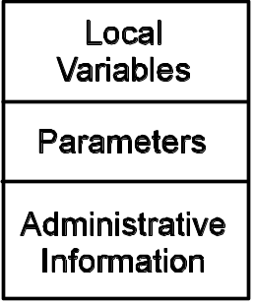
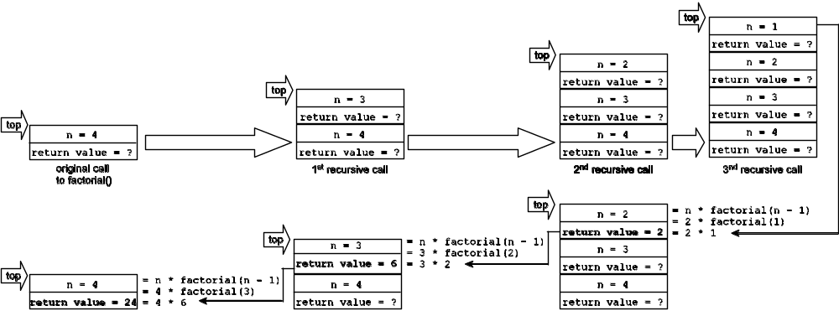
Activation Records & the Process Stack
Contents of an activation record
method calls ⇒
⇐ method returns (recursion unwinding)
State of the process stack and activation records for an initial call to factorial(4)

Slide 35
Tail Recursion
A recursive method call is tail recursive if the recursive call is the last statement to be executed before the method returns
Such methods are of interest because they can easily be converted to use a loop to do the iteration
Why bother? Because tail recursive methods are particularly inefficient in their use of space

Slide 36
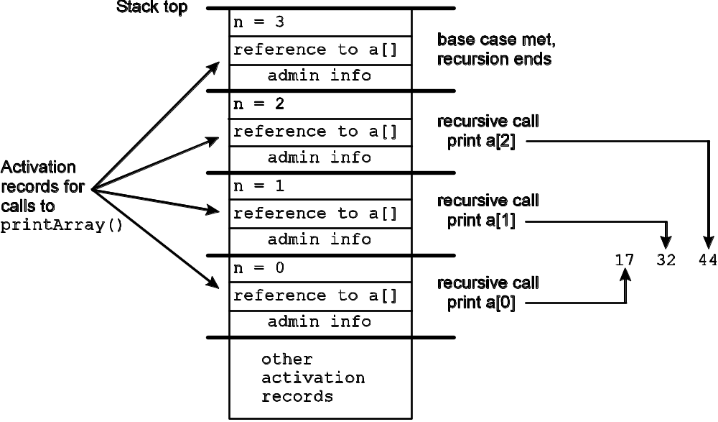
An Example
// print the values from 0 to values.size - 1
void printArray( int[] values, int n ) {
if ( n == values.length ) // base case
return;
System.out.println( values[n] );
n++;
printArray( values, n ); // recursive case
}
tail recursive – data in
the activation record will never be used again

Slide 37
Convert Tail Recursion to a Loop
Recursive Version | Iterative Version (Tail Recursion Removed)
void printArray(int[] values, int n){ if ( n == values.length ) // base case return; System.out.println( values[n] ); n++; printArray( values, n ); // recursive // case } | void printArray( int[] values, int n ){ while ( n != values.length ){ System.out.println( values[n] ); n++; } }

Slide 38
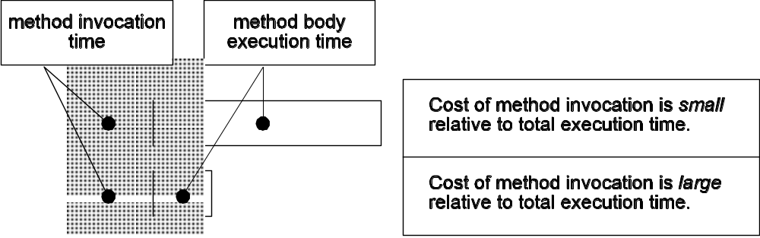
Evaluation Recursion
space
How much space activation records require depends on two factors:
  the size of the activation record, which depends on how many parameters and local variables there are
  the depth of the recursion; that is, how many calls will be made before the base case is met, at which point no more recursive calls are made
Time
The “cost” of the method invocation goes up as the execution time of the body goes down

Slide 39
Dynamic Programming
Occasionally, a recursive definition provides a nice, clear decomposition of a problem, but its implementation results in duplication of effort.
Space-Time Tradeoff: sometimes we would prefer to compute something once and save the value for reuse later rather than re-compute it each time it is needed

Slide 40
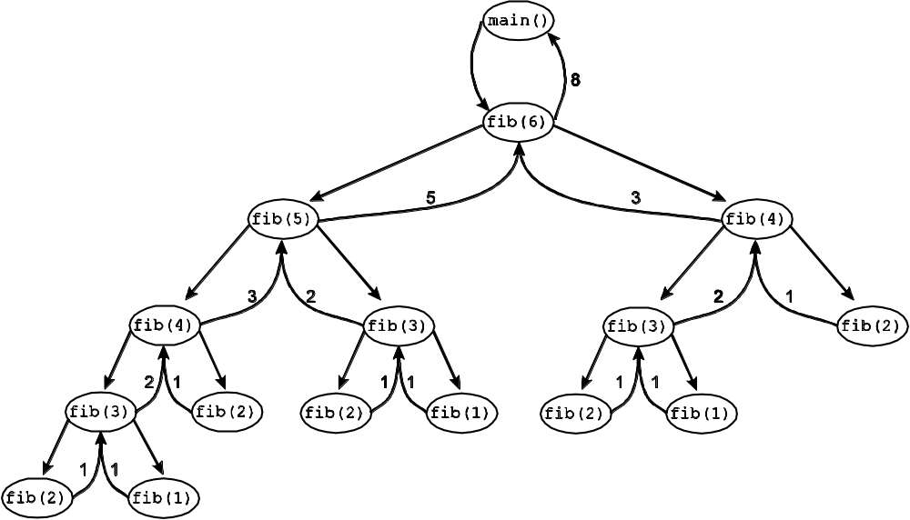
Example: Computing Fibonacci Numbers
recursive
definition
0, if n == 0 base case
fib_{n} =
1, if n == 1 base case
fib_{n – 1} + fib_{n – 2}, if n > 1 recursive case
n | Number of Times fib(n) Is Computed
1 | 3
2 | 5
3 | 3
4 | 2
5 | 1
6 | 1
Call tree for computing the
sixth Fibonacci number.
Count of number of times a Fibonacci number is computed while computing fib(6)

Slide 41
Recursive & Dynamic Programming Versions
// recursive version
long fibonacci( int n ) {
if ( ( n == 0 ) || ( n == 1 ) )
return n;
return fibonacci( n - 1 ) +
fibonacci( n - 2 );
}
/**
* Dynamic programming version of the Fibonacci function.
*/
public class DynamicFibonacci {
private long[] fibs; // store the fibs here
private int lastComputedFib;
private int capacity;
public long getFib( int n ) { // compute and store for reuse
int i;
if ( n > capacity ) return -1;
lastComputedFib++;
for ( ; lastComputedFib <= n; lastComputedFib++ )
fibs[lastComputedFib] = fibs[lastComputedFib - 1] +
fibs[lastComputedFib - 2];
// undo the last ++ from the last iteration of the for loop
lastComputedFib--;
return fibs[lastComputedFib];
}

